Slide 1
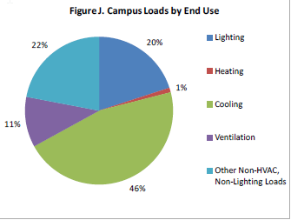
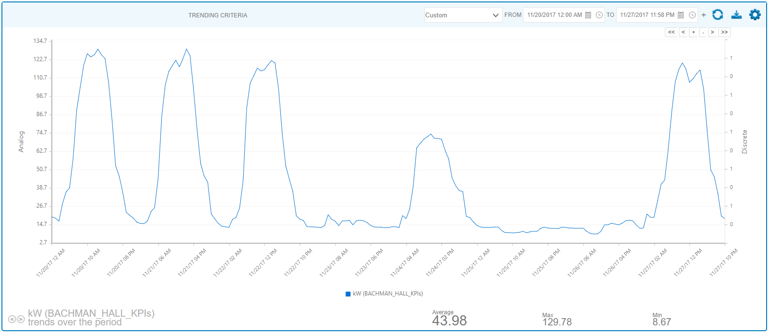
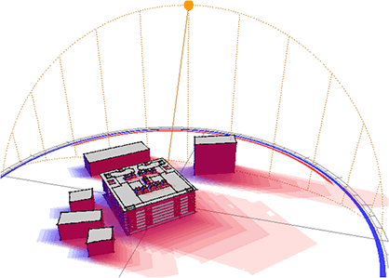
60% of the energy - HVAC
Research Buildings and Libraries Require 24/7 HVAC
Bachman Hall Consumption Trend
HVAC battles the Sun
Notes:
We know from Measurement, Modeling, and Audits that 60% of the Energy consumed goes into the Air Conditioner

Slide 2
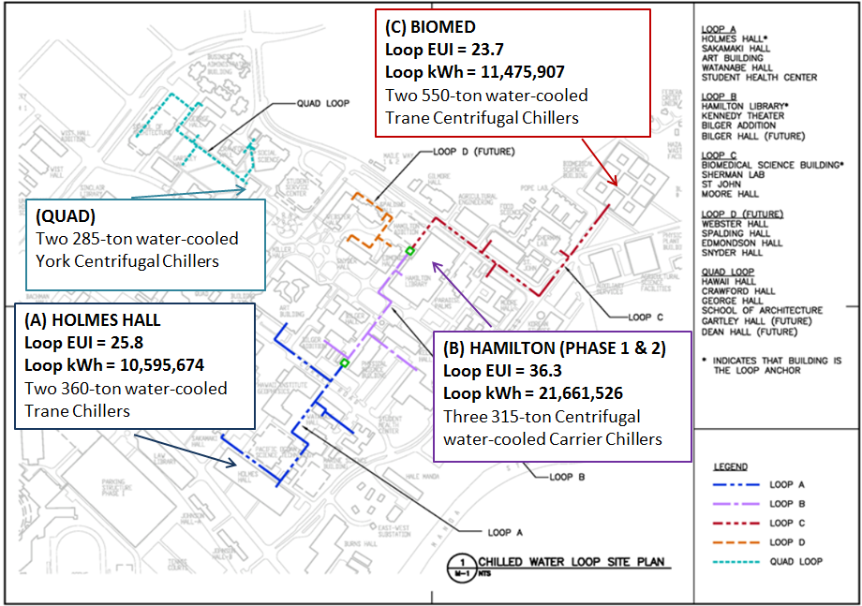
UH Manoa Cooling Loops
Notes:
We have 4 district Cooling loops providing 24/7 cooling to our research buildings, libraries, offices and classrooms

Slide 3
Hottest Day
Coolest Day

Slide 4
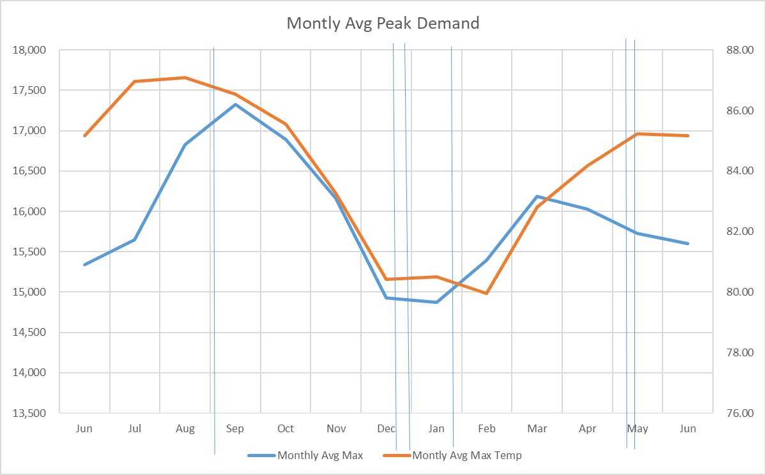
Avg Monthly Peak Demand
Fall Semester
Spring Semester
Winter Break
Finals
Finals
Notes:
You can see that the consumption follows the outdoor recorded temperature.

Slide 5
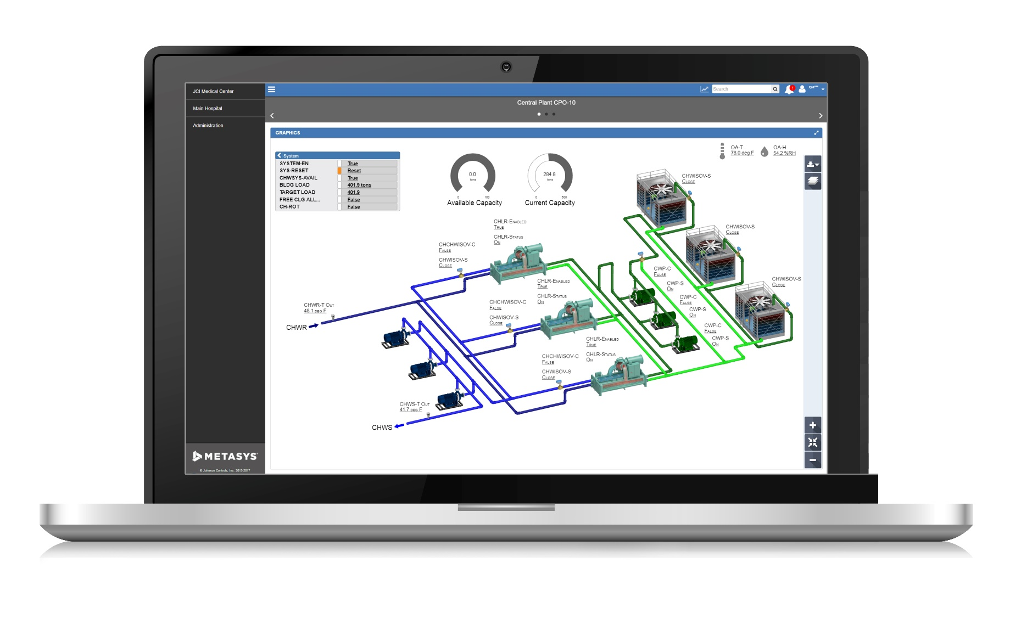
Metasys – DDC, BAS, C0ntrols

Slide 6
HVAC notes
Cooling tower control strategy Floating point with limits
Approach water temp
Supply water temp
Return water temp
Any VFD that is always on is a red flag.
Redundant sensors
If adjusting supply water temp to get right space temp, there is a problem else where, valve or damper.

